Slide 1
AIET Project
Team Nbr:09
Team Name:Olivier Grisel
LICENSE PLATE DETECTION

Slide 2
Agenda
A brief About Olivier Grisel
Team members
Problem statement
Related work
Datasets
Methods and model
Experiments and results
Future work
Conclusion
Q & A

Slide 3
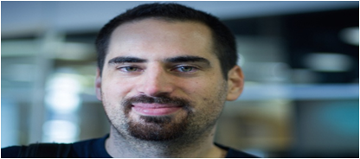
Olivier Grisel
Meet Olivier Grisel, the brain behind Scikit-Learn. He has a specialization in machine learning with applications to natural language processing, text mining and knowledge extraction. He is involved in delivering talks and tutorial sessions on scikit-learn and predictive modelling.

Slide 4
Team
Dirisala Lavanya
Kone Srimannarayana
Kothagundu Venkata Krishna Rao
Penugonda Naga Venkata Raviteja
Tummalapalli Venkata Lakshmi Hiranmai

Slide 5
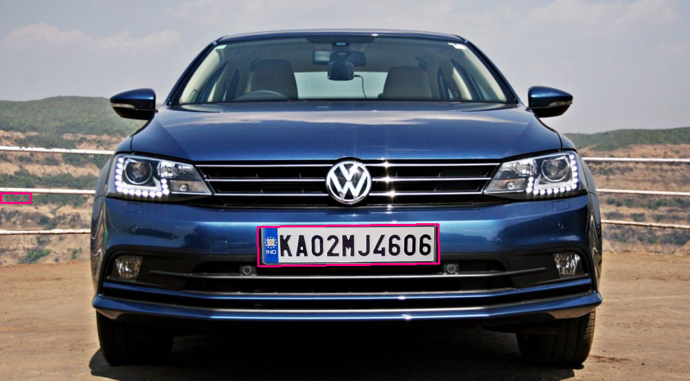
Problem statement
Detecting The License Plate Of Vehicles Using OpenCV And Tesseract

Slide 6


Related work
Image Processing -- Grayscale Image, Binary Image, Finding Contours, Morphology Operations
Localizing the plate
Character Recognition Using Classification Models - K Nearest Neighbours

Slide 7
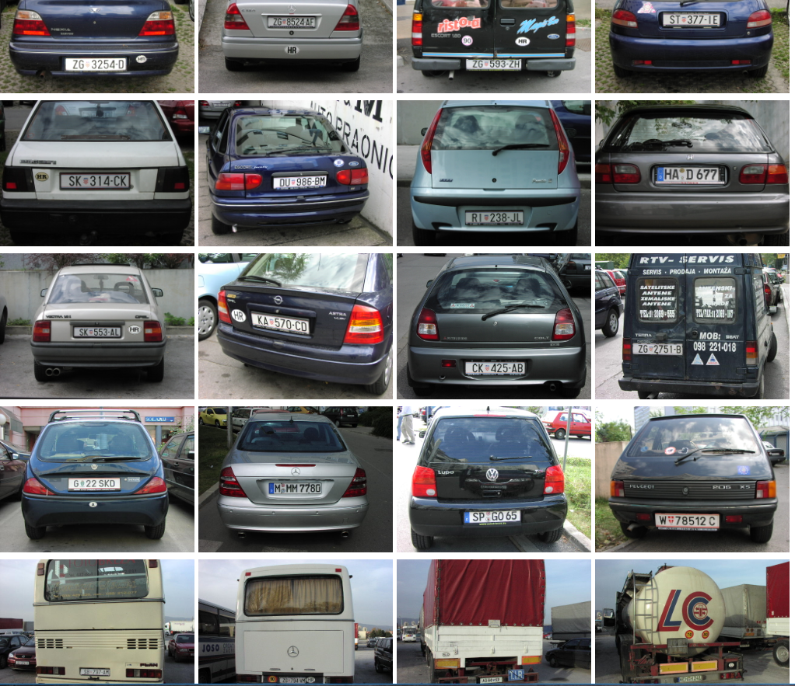
Datasets
https://platerecognizer.com/number-plate-datasets/
The image database contains over 500 images of the rear views of various vehicles (cars, trucks, busses), taken under various lighting conditions (sunny, cloudy, rainy, twilight, night light).

Slide 8
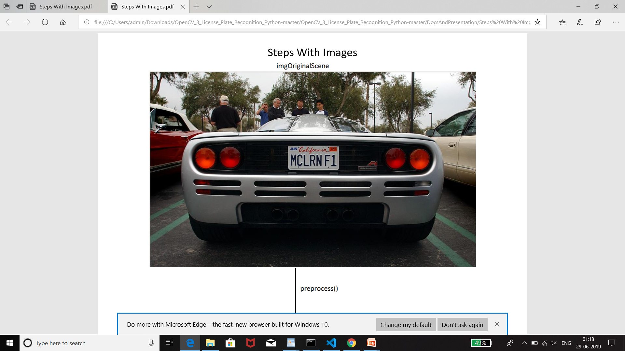
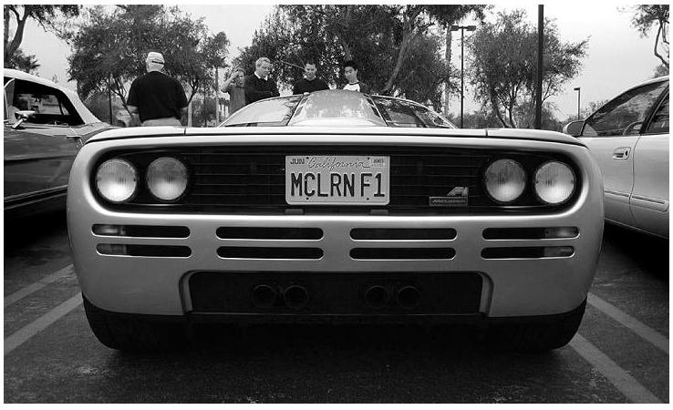
Methods and model
1.Preprocessing
- Converting original image to grayscale

Slide 9
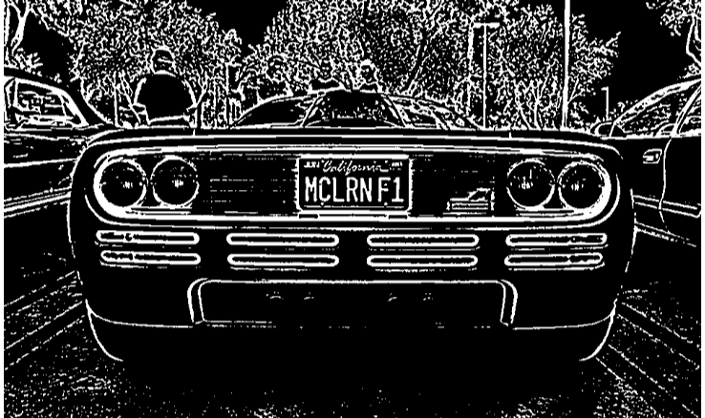
- Converting Grayscale Image To Binary Image

Slide 10
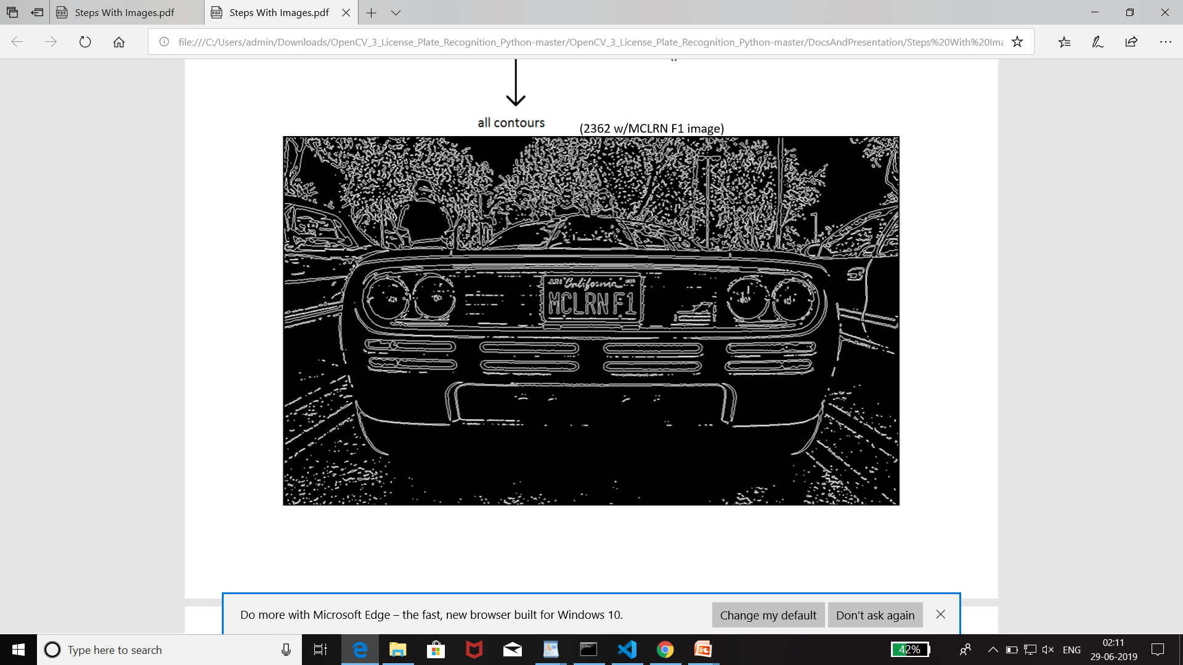
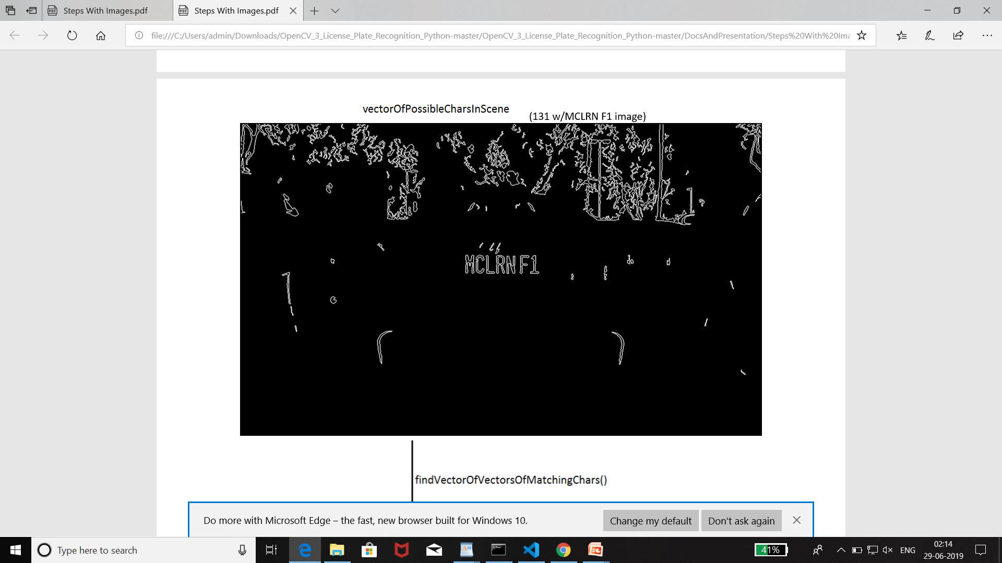
2. Applying contours to find all the possible characters in the binary image

Slide 11
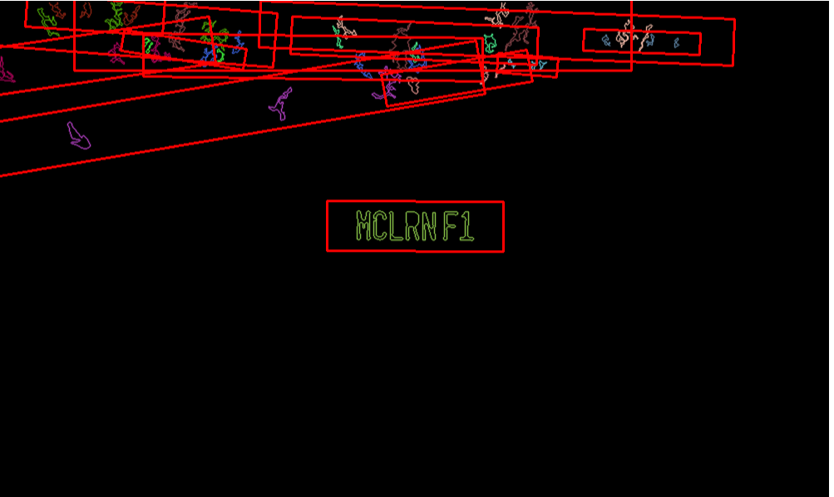
3. Finding all the possible plates after finding the possible characters

Slide 12
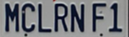
4. Extracting the correct license plate from the list of possible plates

Slide 13
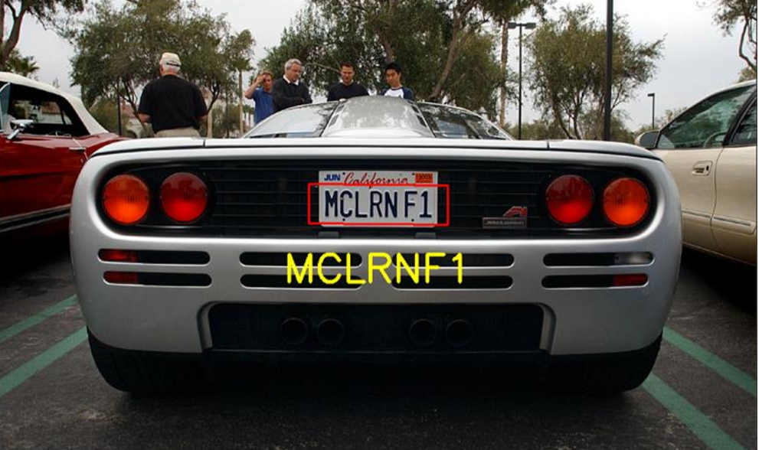
5. Sending the license plate image to tesseract model for character recognition

Slide 14
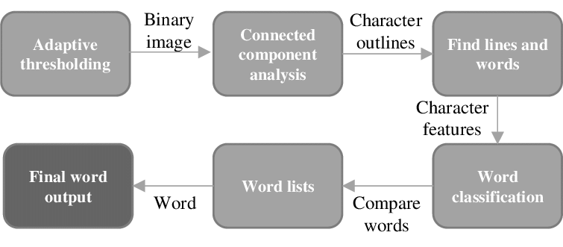
https://www.google.com/url?sa=i&source=images&cd=&cad=rja&uact=8&ved=2ahUKEwjqm9v8_o3jAhXRT30KHb4tA6kQjhx6BAgBEAM&url=https%3A%2F%2Fwww.researchgate.net%2Ffigure%2FTesseract-OCR-engine-architecture_fig4_265087843&psig=AOvVaw2d6cRmlAooNaaE9Am213nq&ust=1561873384500459
Tesseract OCR Engine Architecture

Slide 15
Experiments and results
Classification Accuracy -
Number Of Correct Predictions
Total Number Of Predictions Made
Over 200 .png image files - The accuracy is 80%
Over 300 .jpg image files - The accuracy is 60%
X 100

Slide 16
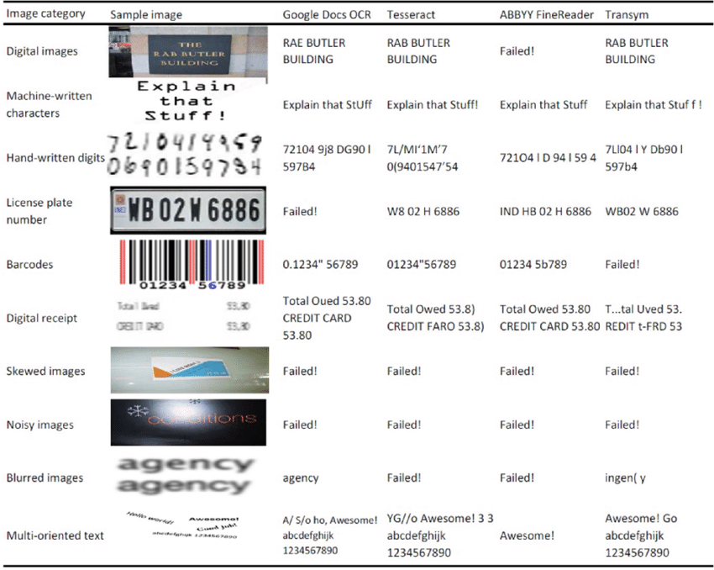
OCR as a Service: An Experimental Evaluation of Google Docs OCR, Tesseract, ABBYY FineReader, and Transym

Slide 17
Future work
After recognising the license plate number, it can be send to traffic police and they can use them to issue fines and file a complaint, if found violating the traffic rules
Criminology Department
Tracking stolen cars
Recognising the license plates in extreme conditions too

Slide 18
Conclusion
In order to get the most accurate results from tesseract, preprocessing the image plays a huge role.
Even though tesseract gives relatively accurate results, it also fails in recognising text in some cases.

Slide 19
Thank you!

